Slide 1
Text Detection and Extraction Using OpenCV and OCR
CS531-Project Final Presentation
Presented By: Niyat, Snit, Saron, Prital

Slide 2

Agenda
Project background and Goal
Target Users
Design
System Workflow
System Features and Design
Technologies Used
Implementation
Backend
Frontend
Database
Testing/Demo
Evaluation and Metrics
Future Enhancements
Challenges and Lessons Learnt
Conclusion

Slide 3
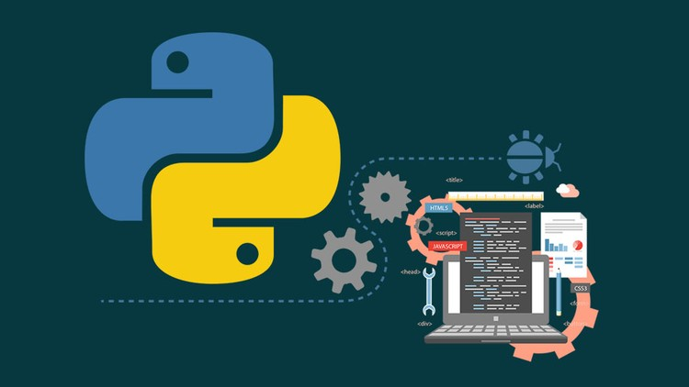
Project Overview
Definition: Text detection and extraction involves identifying text regions within an image and converting the text into machine-readable format.
Applications: Document digitization, automated data entry, etc.
Our Project Aim: Develop an automated system using OpenCV (Open source computer vision) and Tesseract-OCR (optical character recognition) to detect and extract text from images, and optionally translate and summarize.
Initial Proposal:
Develop an automated system to detect and extract text from images.
Utilize OpenCV and Tesseract-OCR as the core technologies for text detection and extraction.
Extended Goals:
Integrate a translation feature to convert the extracted text into multiple languages.
Add a summarization feature to generate concise summaries of the extracted text.
Ensure a user-friendly interface that allows easy interaction with all features.
Notes:
Definition: Text detection and extraction involves identifying text regions within an image and converting the text into machine-readable format.
Applications: Document digitization, automated data entry, etc.
Initial Proposal:
Develop an automated system to detect and extract text from images.
Utilize OpenCV and Tesseract-OCR as the core technologies for text detection and extraction.
Extended Goals:
Integrate a translation feature to convert the extracted text into multiple languages.
Add a summarization feature to generate concise summaries of the extracted text.
Ensure a user-friendly interface that allows easy interaction with all features.
Our Project Aim: Develop an automated system using OpenCV (Open source computer vision) and Tesseract-OCR (optical character recognition) to detect and extract text from images, and optionally translate and summarize.
Goal:
Accurate Text Detection and Extraction
Seamless Translation of Extracted Text into Multiple Languages
Concise Summarization of Extracted Text for Quick Insights
User-Friendly Interface with Multiple Text Processing Options
Efficient Storage and Retrieval of Processed Data

Slide 4

Target Users
Businesses and Organizations: For automating document processing, data entry, and archival.
Educational Institutions: To convert printed textbooks and research materials into digital formats.
Healthcare Providers: For digitizing patient records and handwritten notes.
Developers and Data Scientists: As a tool for integrating text extraction into various applications and research projects.

Slide 5
Design

Slide 6
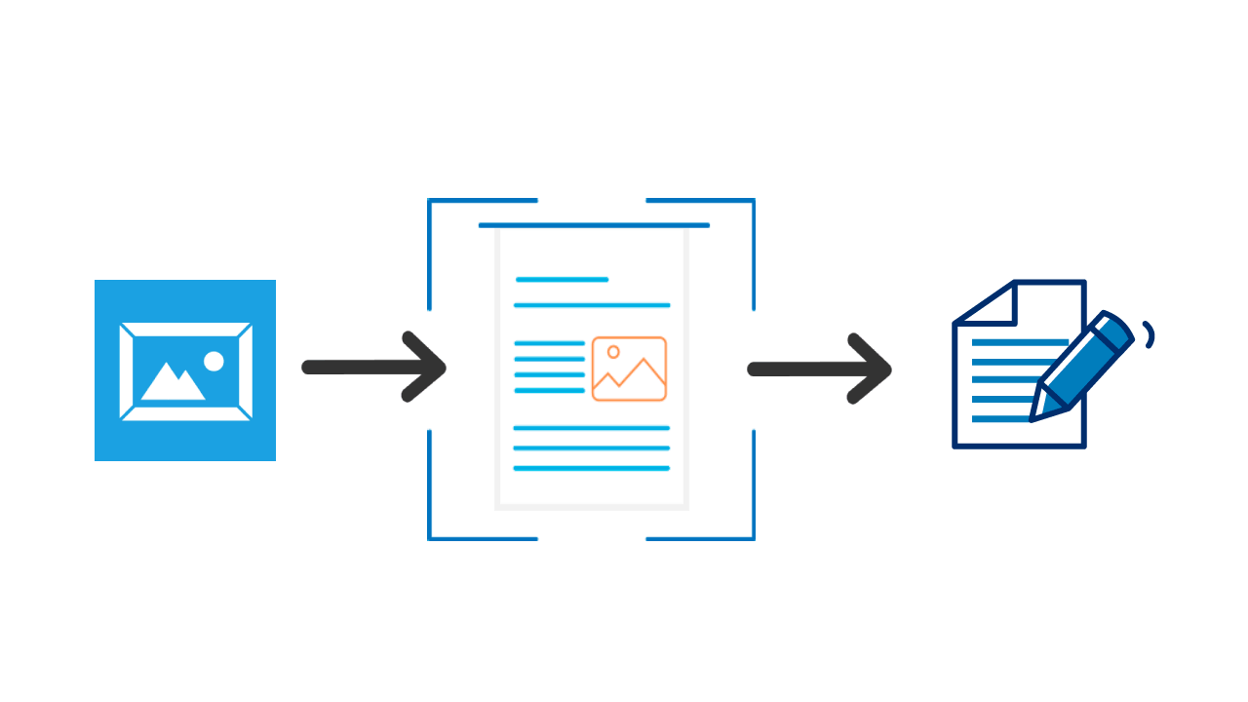
System Features
User :
Uploads an image via the web interface and chooses to view, translate, or summarize the extracted text.
Text Processing:
Image is processed for OCR using Tesseract.
Extracted text is stored and displayed.
Optional: Text is translated or summarized based on user input.
Database Interaction:
Image metadata, extracted text, and processing results are stored in a MySQL database.
User can retrieve a history of processed images.
UI/Output:
Processed text is displayed on the web interface.
User can view, translate, or summarize the text as required.
Notes:
User: The user uploads an image via the web interface and chooses whether to view, translate, or summarize the extracted text.
Text Processing: The uploaded image is processed for OCR using Tesseract. Extracted text is displayed and optionally translated or summarized based on user input.
Database: Image metadata, extracted text, and processing results are stored in a MySQL database. The user can retrieve a history of processed images.
Output: The processed text is displayed on the web interface. The user can view, translate, or summarize the text as needed.

Slide 7
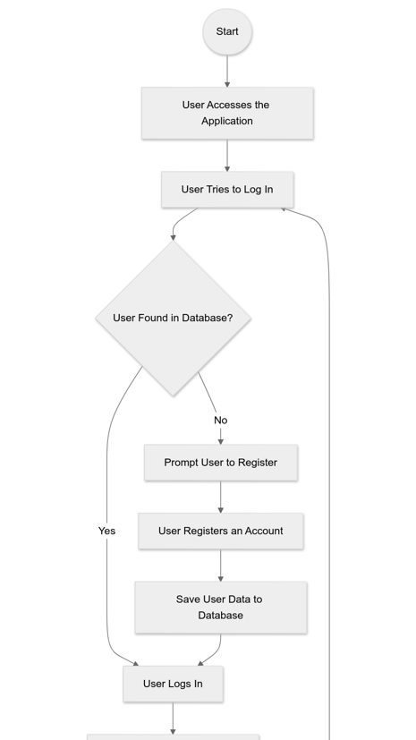
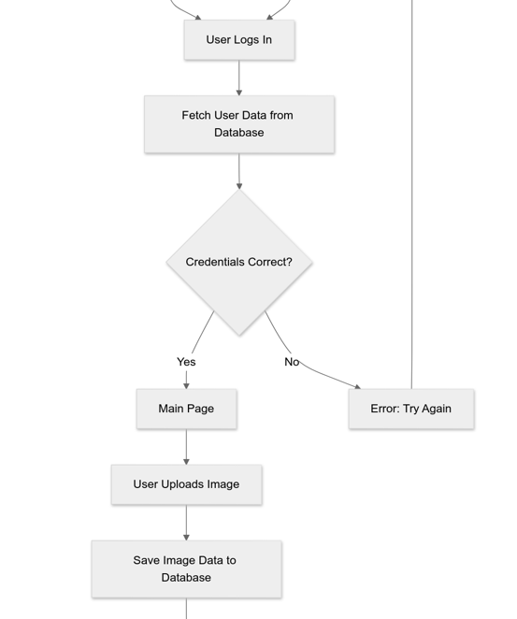
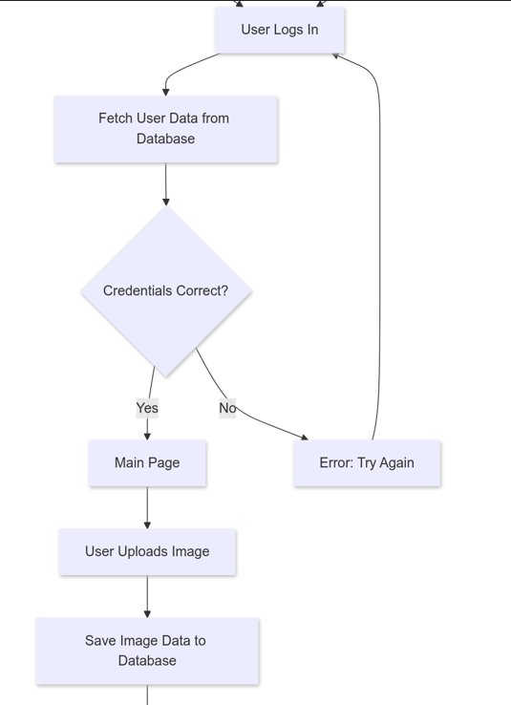
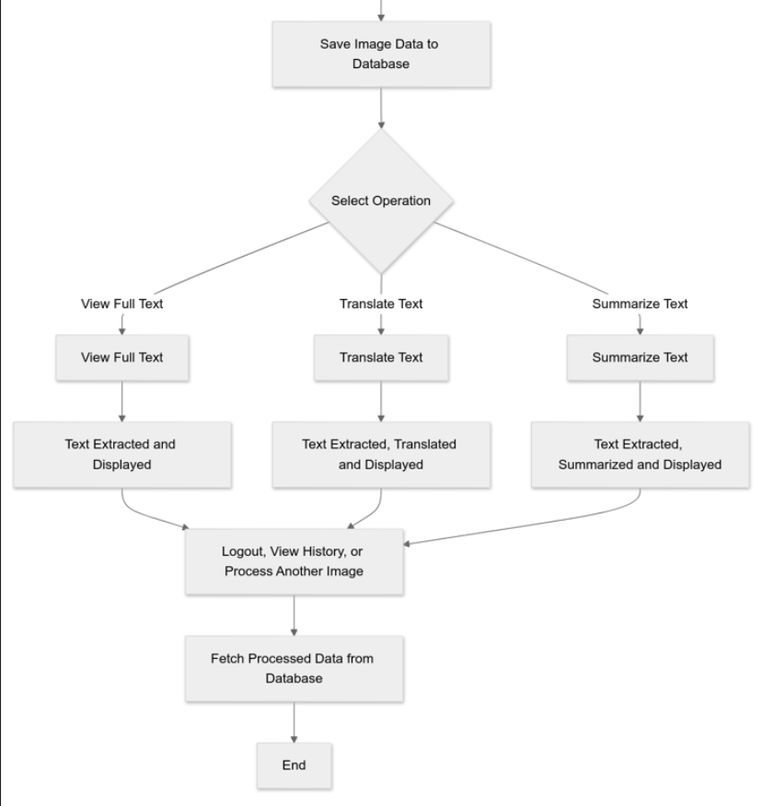
System Workflow

Slide 8

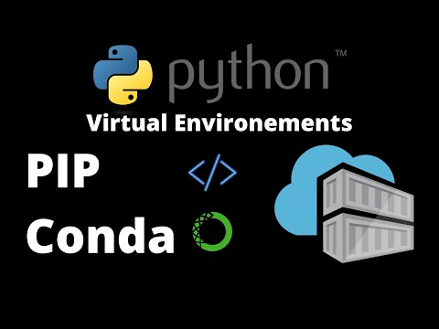
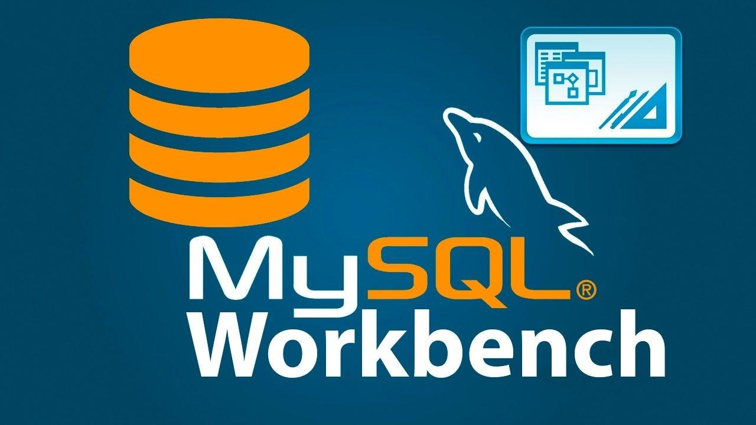
Technology Stacks
Development Tools:
VS Code: Main IDE for development.
MySQL Workbench: For database management.
Conda Environment: Isolated Python environment to manage dependencies.
Environment Setup:
Conda Environment: Created with necessary dependencies for the project.
VS Code Extensions:
Python
Flask Snippets
Pylint
Jinja

Slide 9
System Design
System Features:
HTML/CSS: For creating a responsive and user-friendly web interface.
JavaScript: For enhancing interactivity on the web pages.
Flask: To handle routing, form submissions, and server-side processing.
Tesseract-OCR: For extracting text from uploaded images.
Google Cloud Translate: For translating extracted text into multiple languages.
Hugging Face Transformers: For summarizing extracted text.
SQL: For managing user data, image metadata, and text processing history.

Slide 10
System Design
Objective: Develop a web-based platform for text detection, extraction, translation, and summarization from images.
Frontend:
HTML/CSS/JavaScript: User Interface design with a responsive layout.
Flask-Jinja2: Templating for dynamic web pages.
Backend:
Flask Framework: Handles routing, requests, and responses.
Tesseract-OCR: Optical Character Recognition for extracting text from images.
Google Cloud Translation API: For translating extracted text into multiple languages.
Transformers (Hugging Face): For summarizing extracted text.
C. Database:
MySQL: Stores user data, image metadata, and processed results.
MySQL Workbench: Database management and query execution.
D. Storage:
File System: Stores uploaded images.

Slide 11

Modules and Packages
Imported Modules:
Flask: ‘Flask’, ‘render_template’, ‘request’, ‘session’, ‘flash’, ‘redirect’, ‘url_for’
Werkzeug: ‘secure_filename’
OpenCV: ‘cv2’
Pytesseract: ‘pytesseract’
Google Cloud Translate: ‘translate_v2 as translate’
Langdetect: ‘lang_detect’
Transformers: ‘pipeline’
MySQL Connector: ‘mysql.connector’
OS/Datetime: ‘‘os’, ‘datetime’
Installed Packages:
opencv-python: OpenCV library for image processing.
pytesseract: Python wrapper for Tesseract-OCR.
Flask: Web framework.
google-cloud-translate: Google Cloud API for translation.
langdetect: Library for detecting text language.
transformers: Hugging Face Transformers for text summarization.
mysql-connector-python: Python MySQL connector.

Slide 12
Implementation

Slide 13
Backend Design
app.py python file
Purpose:
User Management: Register, log in, and manage user sessions.
Image Upload and Processing: Upload images, extract text, translate, and summarize.
Database Interaction: Store user and image data, track uploads.
File Handling: Serve and download images and extracted text files.
Functionalities:
User Registration: Create accounts with hashed passwords.
User Login: Authenticate and start sessions.
User Logout: End sessions and clear user data.
Home Page: Main page for authenticated users or redirects to login.
File Upload: Upload images, process them, and handle text operations.
View Upload History: List user’s uploaded images and extracted text.
Serve Uploaded Files: Display uploaded images.
Download Extracted Text: Download text files of extracted text.

Slide 14
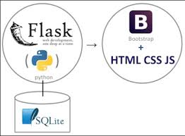
Backend Design
app.py python file
Key Libraries:
os: File and directory operations.
mysql.connector: MySQL database connectivity.
cv2: OpenCV for image processing.
pytesseract: OCR for text extraction from images.
langdetect: Language detection.
google.cloud.translate_v2: Google Cloud Translation API.
transformers: Text summarization pipeline.
flask: Web framework for creating the application.
werkzeug.security: Password hashing and checking.

Slide 15
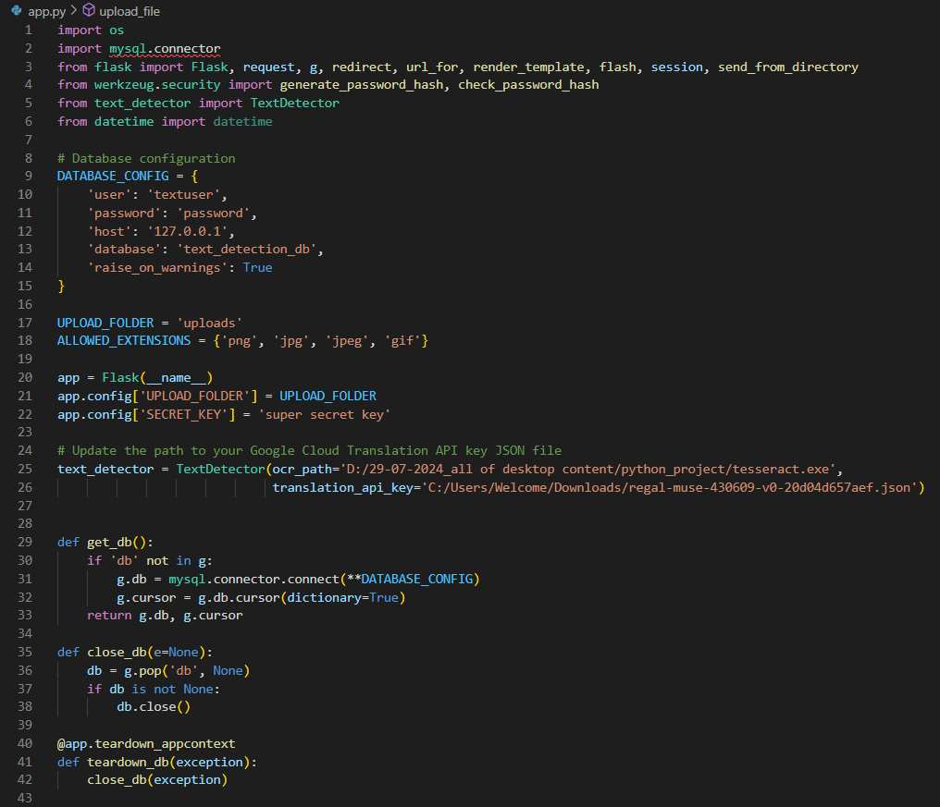
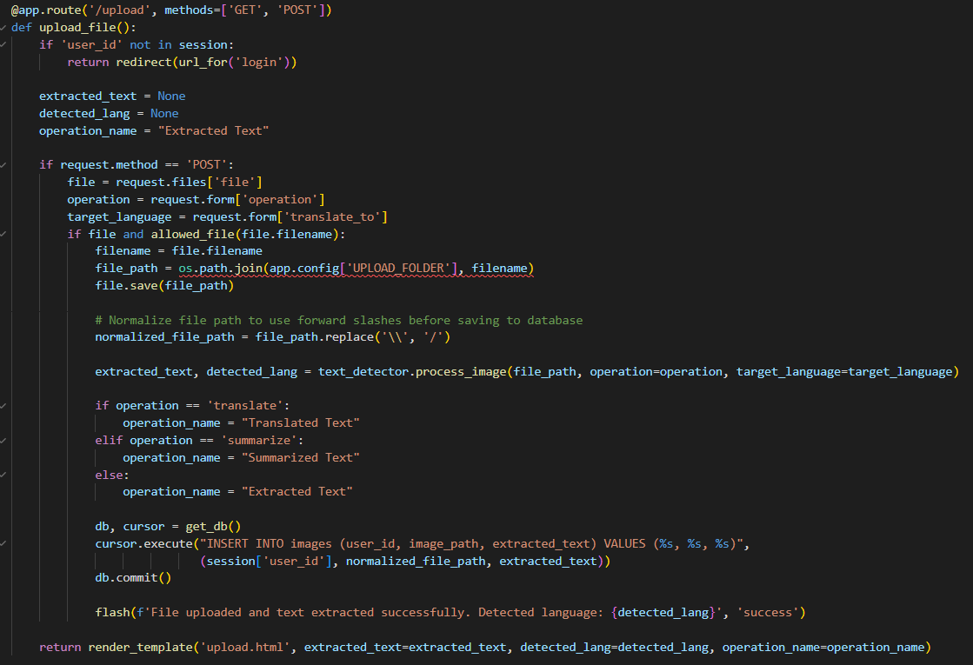
Backend Design
app.py python file

Slide 16
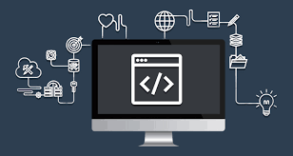
Backend Design
Text_Detector.py python file
Purpose:
Text Detection and Extraction: Converts images into machine-readable text using OCR.
Language Detection: Identifies the language of the extracted text to facilitate further processing.
Translation: Provides the capability to translate extracted text into a different language using Google Cloud services.
Text Summarization: Offers a summary of the text for quick insights, reducing the need to read large volumes of extracted text.
Functionalities:
Image Preprocessing (preprocess_image): Converts images to grayscale and applies thresholding for better text extraction.
Contour Detection (detect_contours): Identifies regions within the image likely to contain text.
Text Extraction (extract_text_from_image): Extracts text from the detected contours using Tesseract-OCR.
Language Detection (detect_language): Detects the language of the extracted text automatically.
Text Translation (translate_text): Translates the text to a specified target language using the Google Cloud Translation API.
Text Summarization (summarize_text): Summarizes the extracted text into a shorter, concise form.

Slide 17
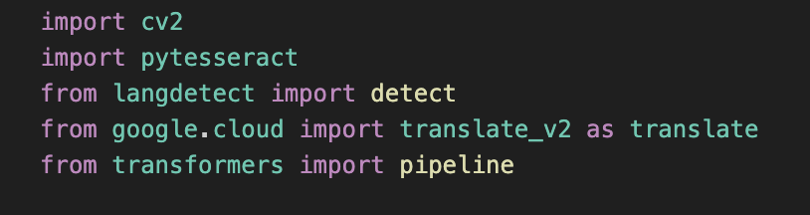
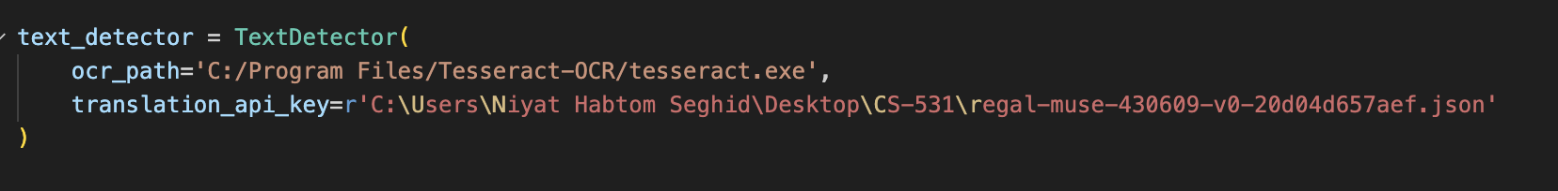
Backend Design
Text_Detector.py python file
Key Libraries:
OpenCV: For image processing (cv2).
Tesseract-OCR: For text extraction (pytesseract).
LangDetect: For language detection (detect).
Google Cloud Translation API: For text translation (translate).
Transformers: For text summarization (pipeline).

Slide 18
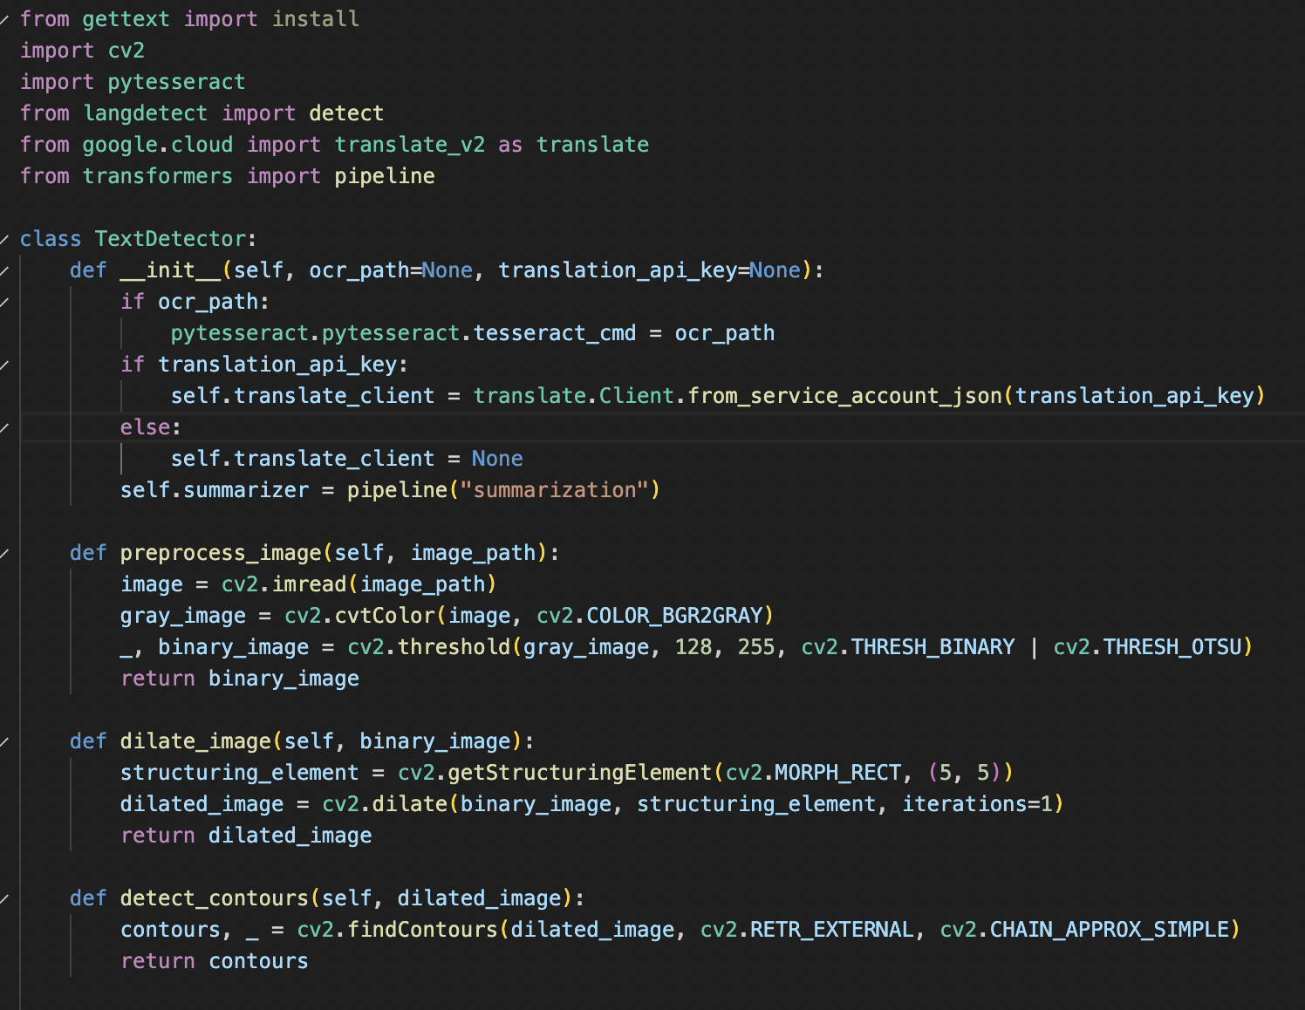
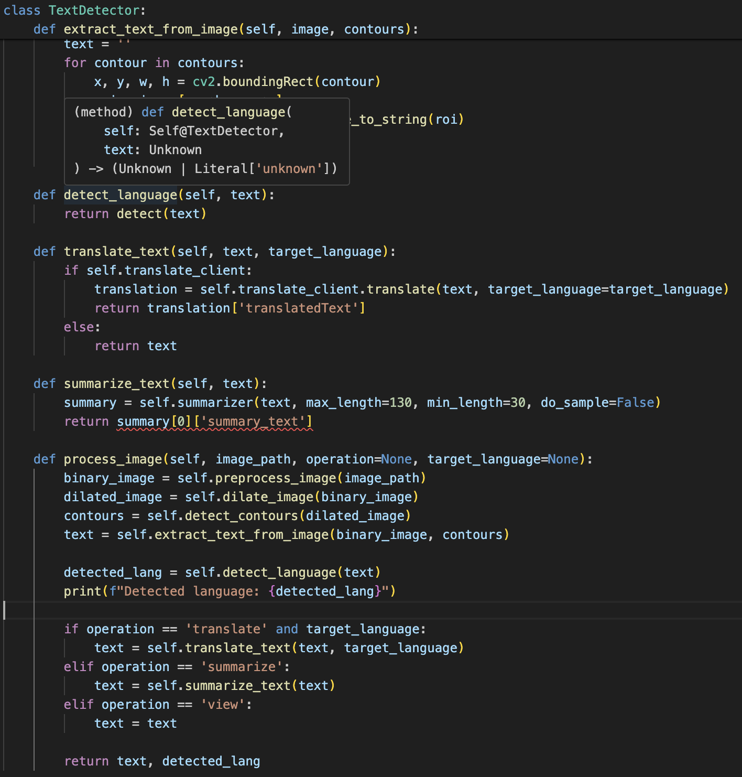
Backend Design
Text_Detector.py python file

Slide 19

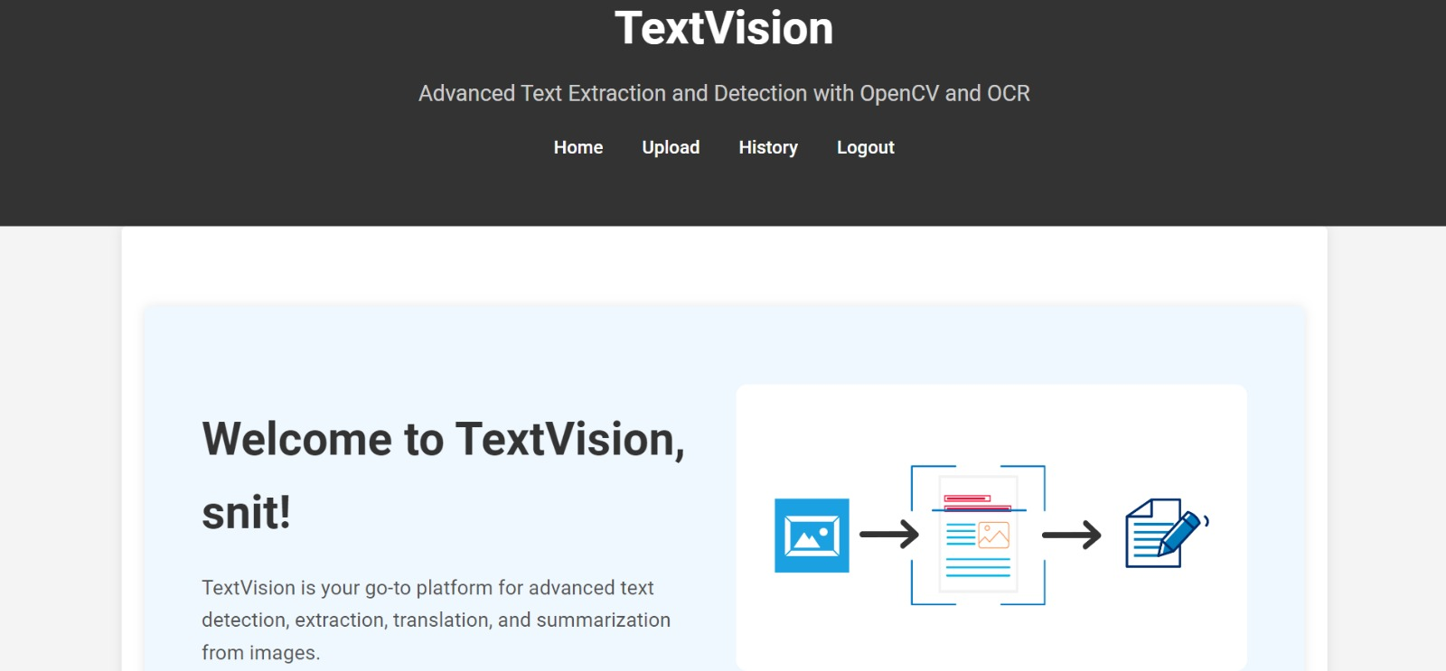
Frontend Design
Technologies Used: HTML, css
Key HTML Files:
Allows users to register and log into their account.
Manage user authentication and account creation.
Facilitate image uploads and initiate text extraction processes.
Allow users to view their previously processed images and extracted text.

Slide 20
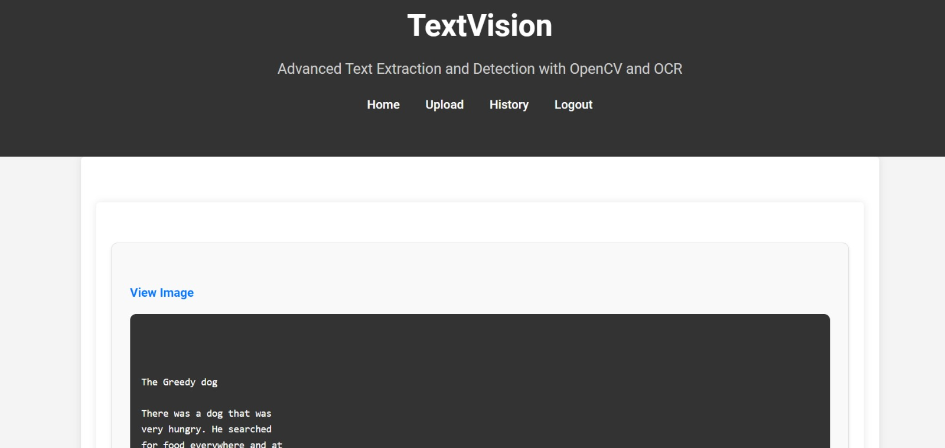
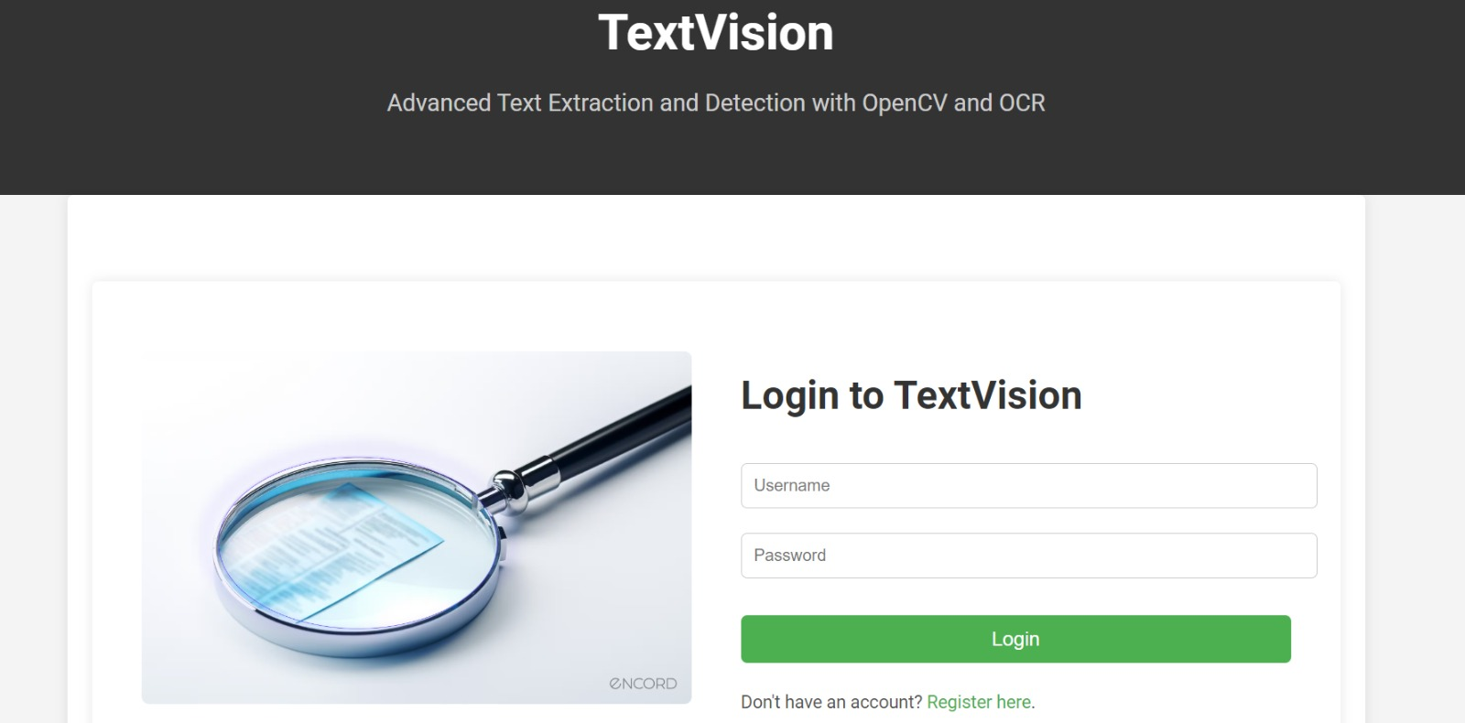
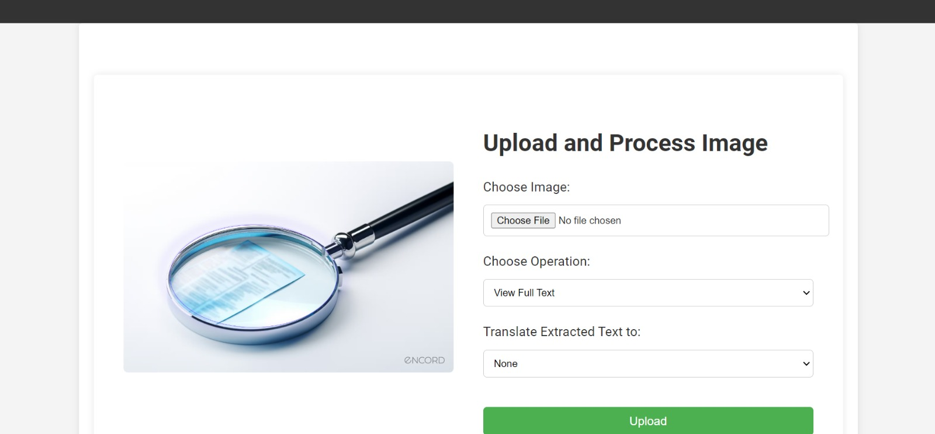
User Interface

Slide 21
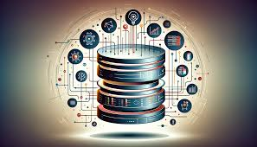
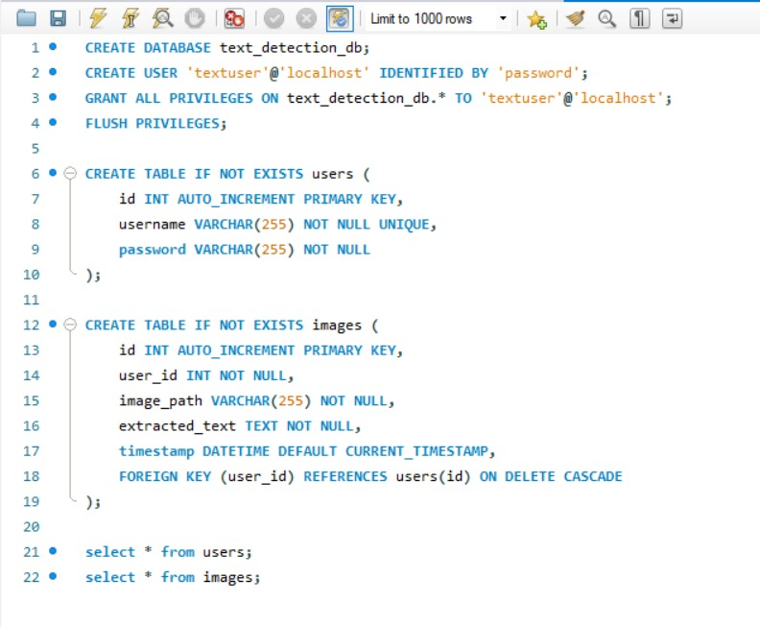
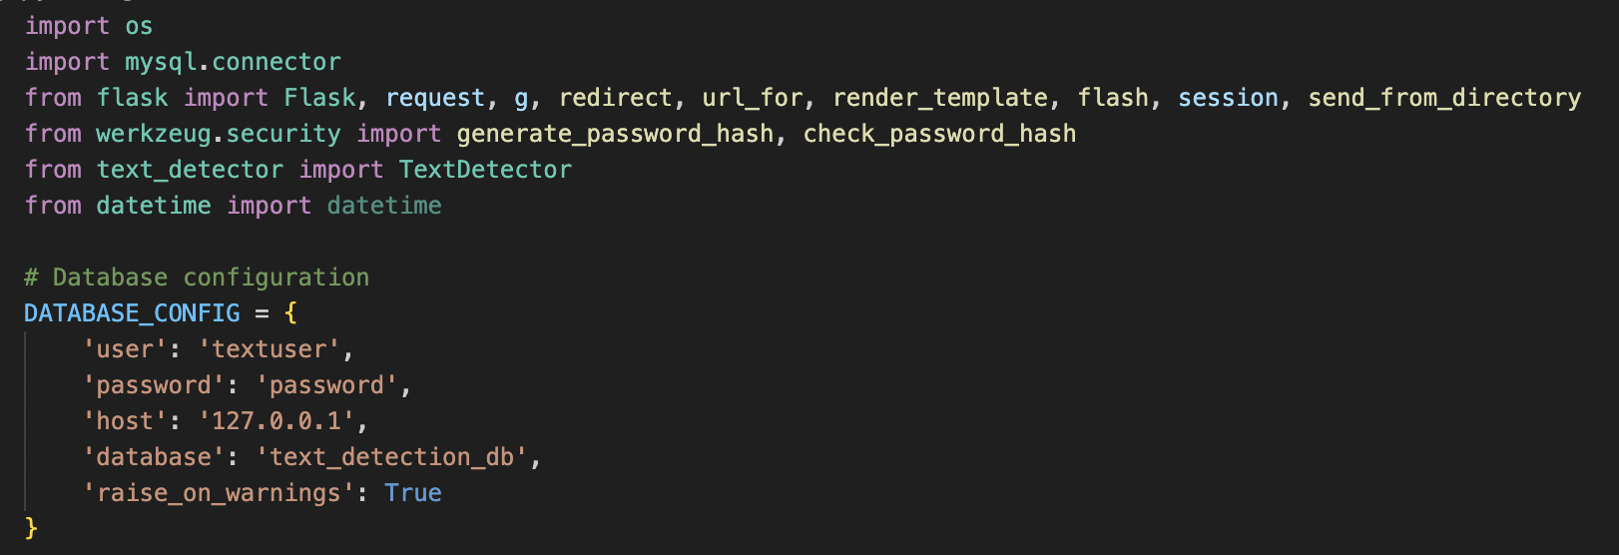
Database
Step 1: Database Connection

Slide 22
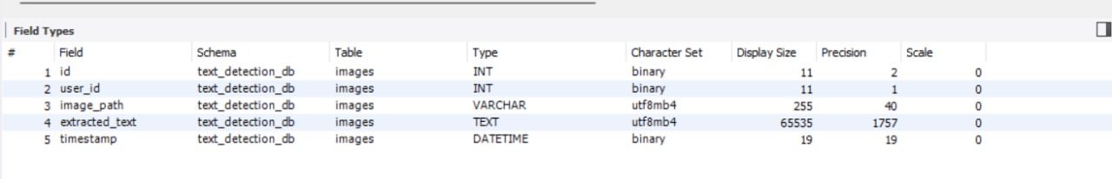
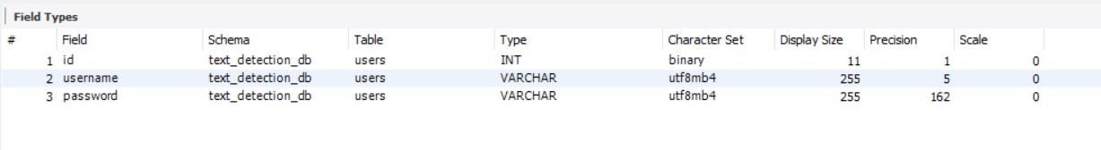
Database
Step 2: Create table to store users and the images uploaded

Slide 23
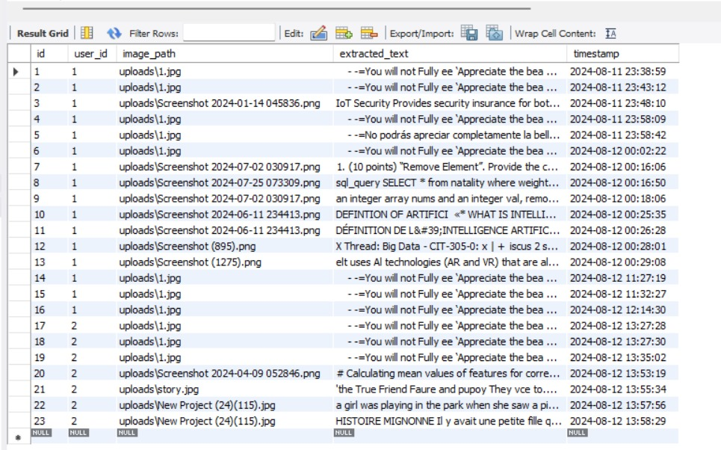
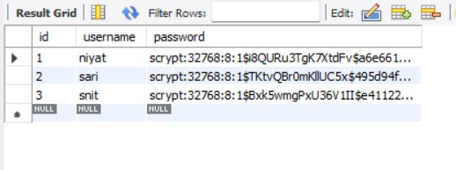
Database
Step 3: Run the program and check the updated tables

Slide 24
Testing / Demo

Slide 25
Evaluation Metrics
Text Extraction Accuracy: Compared extracted text with manually annotated data.
Translation Accuracy: Assessed for quality.
Summarization Quality: Compared generated summaries with human-written ones.
Processing Time: Measured the speed of text extraction, translation, and summarization.
User Feedback: Collected feedback on usability and system performance.
Robustness: Tested system performance with varying image qualities and multiple languages.

Slide 26

Future Enhancements
Improved Accuracy: Incorporate advanced OCR models and deep learning techniques to enhance text recognition accuracy, especially for diverse fonts and languages.
Real-Time Processing: Optimize the system for real-time text extraction in video streams.
Integration with Other Systems: Develop APIs for seamless integration with other software and platforms.
User Interface Improvements: Create a user-friendly interface for non-technical users to easily utilize the system.

Slide 27

Challenges and Lessons Learnt
Challenges
Varied Text Formats: Handling different fonts, sizes, and orientations of text within images.
Complex Backgrounds: Managing text extraction from images with noisy or complex backgrounds.
Working online, incompatible dependencies, different hardware, etc.
Lessons Learned
Technical Skills:
Flask (Backend)
MySQL (Database Operations)
Git (Version Control in a Team Setting)
Soft Skills:
Team Collaboration & Communication
Problem Solving Skills:
Adaptability, Time Management, Asking Questions

Slide 28
Conclusion
The development of a text detection and extraction system using OpenCV and OCR has provided valuable benefits across various domains.
We gained technical skills in frontend/UI development, Flask for backend operations, MySQL for database management, and Git for version control within a team setting.
We also improved our soft skills, particularly in team collaboration and communication.
These skills and experiences will guide us in making future enhancements, allowing us to effectively address challenges and incorporate advanced technologies to create a more efficient and accurate text extraction system.

Slide 29
Thank you!
Any Questions?

